Slide 1
From Noise to Image: Understanding Diffusion Models as Residual Networks
Mahesh Godavarti
Deep Learning/AI Enthusiast GitHub: github.com/mahesh-Godavarti LinkedIn: linkedin.com/in/maheshgodavarti

Slide 2
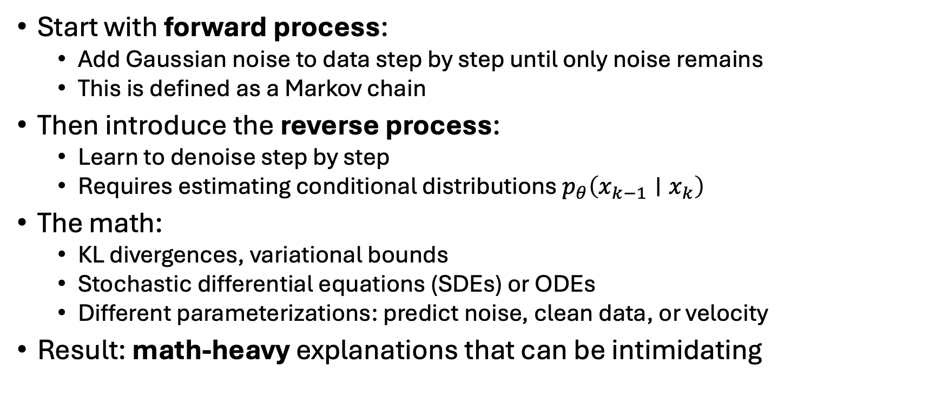
Typical Introduction to Diffusion Models
Start with forward process:
Add Gaussian noise to data step by step until only noise remains
This is defined as a Markov chain
Then introduce the reverse process:
Learn to denoise step by step
Requires estimating conditional distributions $p_{θ}\left(x_{k−1}∣x_{k}\right)$
The math:
KL divergences, variational bounds
Stochastic differential equations (SDEs) or ODEs
Different parameterizations: predict noise, clean data, or velocity
Result: math-heavy explanations that can be intimidating

Slide 3
Understanding Diffusion Models via Toy MNIST ResNet model

Slide 4
Diffusion Process
x₀ = x_{noise} →
x₁ = (1 - 1/N) x_{noise} + 1/N x_{image} →
x₂ = (1 - 2/N) x_{noise} + 2/N x_{image} →
… →
x_{N-1} = 1/N x_{noise} + (1– 1/N) x_{image} →
x_{N} = x_{image}

Slide 5
Deep Neural Network Idea
Let’s say we want to use a DNN to generate images from noise
x_{noise} → DNN → x_{image}
What if the DNN had N layers
x_{noise} → Layer 1 → Layer 2 → … → Layer N → x_{image}
PROBLEM: Difficult to train such a network directly (input is pure noise!)

Slide 6
Solution: Assign expected input at each layer
x_{noise} → Layer 1 = x₁ → Layer 2 = x₂ … x_{N-1} → Layer N → x_{N} = x_{image}
We have input and output for each layer
Predict x_{k+1} from x_{k}
Predict x_{clean} from x_{k} (use layers k through N)
Problem: But still no way to train the first layer (input to Layer 1 is pure noise!)
Solution: Force the first layer share parameters with one of the other layers
Problem: But which layer to share parameters with?
Solution: What if all the layers had the same parameters? Problem solved!

Slide 7
Predict x_{k+1} from x_{k}
For layer k, Loss function = || f(x_{k}) – x_{k+1}||²
x_{k}= (1 – k/N) x_{noise} + k/N x_{clean}
Choose the popular ResNet architecture
f(x_{k}) = x_{k} + F(x_{k}) ➔ F(x_{k}) = 1/N (x_{clean} - x_{noise})
i.e. recover x_{clean} from x_{noise} by repeated application of a “small correction” 1/N (x_{clean} - x_{noise})

Slide 8
Alternative Formulation: Predict x_{clean} from x_{k}
For layer k, Loss function = || g(x_{k}) – x_{k+1}||²
x_{k}= (1 – k/N) x_{noise} + k/N x_{clean}
Choose the popular ResNet architecture
g(x_{k}) = x_{k} + k F(x_{k}) ➔ F(x_{k}) = 1/N (x_{clean} - x_{noise}) (F() is still the same as before!)

Slide 9
Equivalence
In DDIM and DDPM, 1/N F() is called the noise predictor
In Flow Matching, F() is called the velocity field

Slide 10
Takeaway
Diffusion models are just very deep ResNets
Each layer = one denoising step

Slide 11
The Obligatory Gen AI Slide

